Slide 1
Fraud Detection Using Machine Learning
CMPS 470 Final Project - Code Crafters

Slide 2
Team Members
Fiyinfoluwa Osifala – model implementation, visualizations, GitHub management.
Shakurah Watson - Data preparation , Testing.

Slide 3
Project Description
The objective of this project is to develop a machine learning-based application capable of accurately classifying financial transactions as either fraudulent or legitimate. This is achieved by applying four different supervised learning algorithms: Artificial Neural Networks (ANN), Support Vector Machines (SVM), Decision Trees (DT), and k-Nearest Neighbors (K-NN).
The project involves a full ML workflow:
Data Visualization: Initial inspection of distributions and class imbalances
Preprocessing: Cleaning, normalization, and data partitioning into training and test sets
Feature Engineering: Selecting and preparing features such as transaction amount and account age
Model Implementation: Designing and training classifiers using ANN, SVM, DT, and K-NN
Evaluation: Assessing performance using confusion matrices, accuracy, and ROC curves
Interface Design: Creating a command-line interface to allow the user to select a model, train it, test it, and export results and model files

Slide 4
Raw Data Description
The dataset simulates financial transactions with labeled fraud outcomes. Each row represents a single transaction
Attributes and Types:
Sample_ID – Integer: Unique ID for each transaction
Amount – Float: Dollar value of the transaction
Account_age – Float: Age of the account in months
Fraud_Label – Integer: 0 = Not Fraud, 1 = Fraud (target variable)

Slide 5
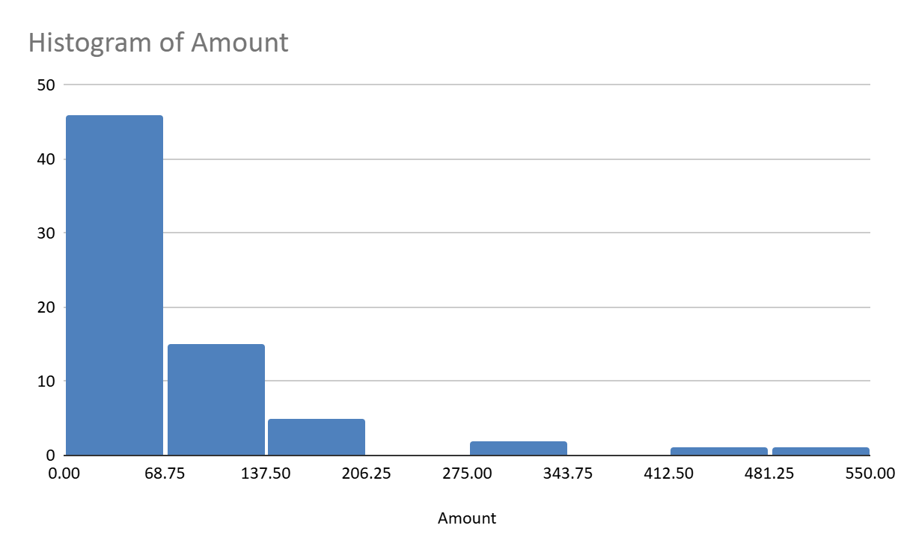
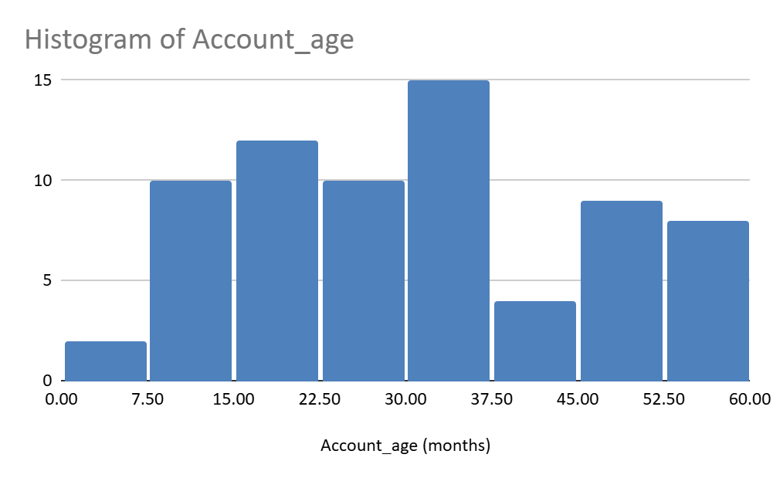
Distribution Highlights
Amount: Mostly small-to-moderate values
Account_age: Accounts range from new to long-term

Slide 6
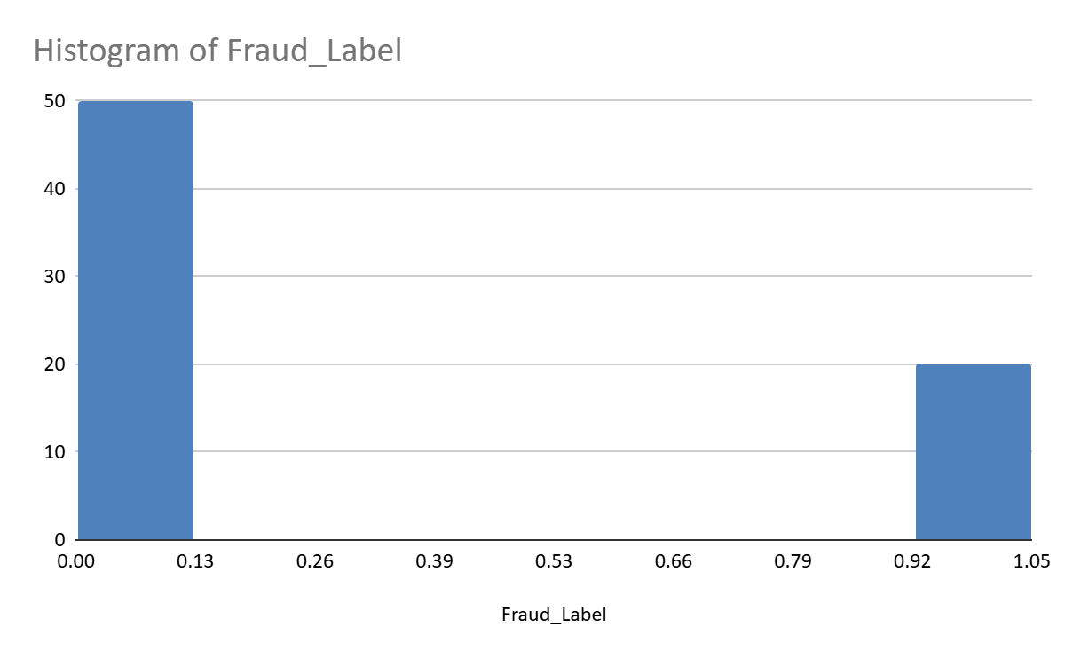
Fraud_Label: Imbalanced dataset
Feature Selection:
Only Amount and Account_age were used as features
No additional feature processing or transformation was done

Slide 7
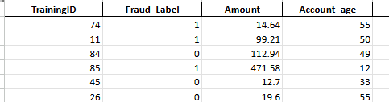
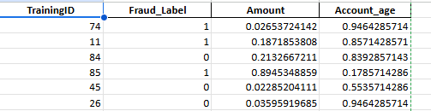
Data Preprocessing
Removed duplicate rows to ensure each transaction is unique
Checked for and confirmed no missing values in critical columns
Verified that Amount and Account_age were properly formatted as numeric types
Standardized input features (scaling) only for ANN and SVM models using StandardScaler
Split the dataset into separate training and testing Excel files
Organized files into structured folders: INPUT/TRAIN, INPUT/TEST, MODEL, OUTPUT
Exported cleaned and preprocessed datasets to Excel format for reproducibility
🧪 Preprocessing Parameters:
Scaling method: StandardScaler (mean = 0, std = 1) — used only for ANN and SVM
No encoding or feature transformation applied (numeric inputs used as-is)
Raw_Dataset Preprocessed_Dataset

Slide 8
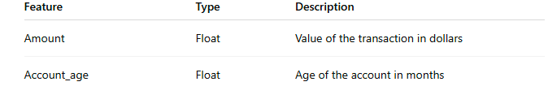
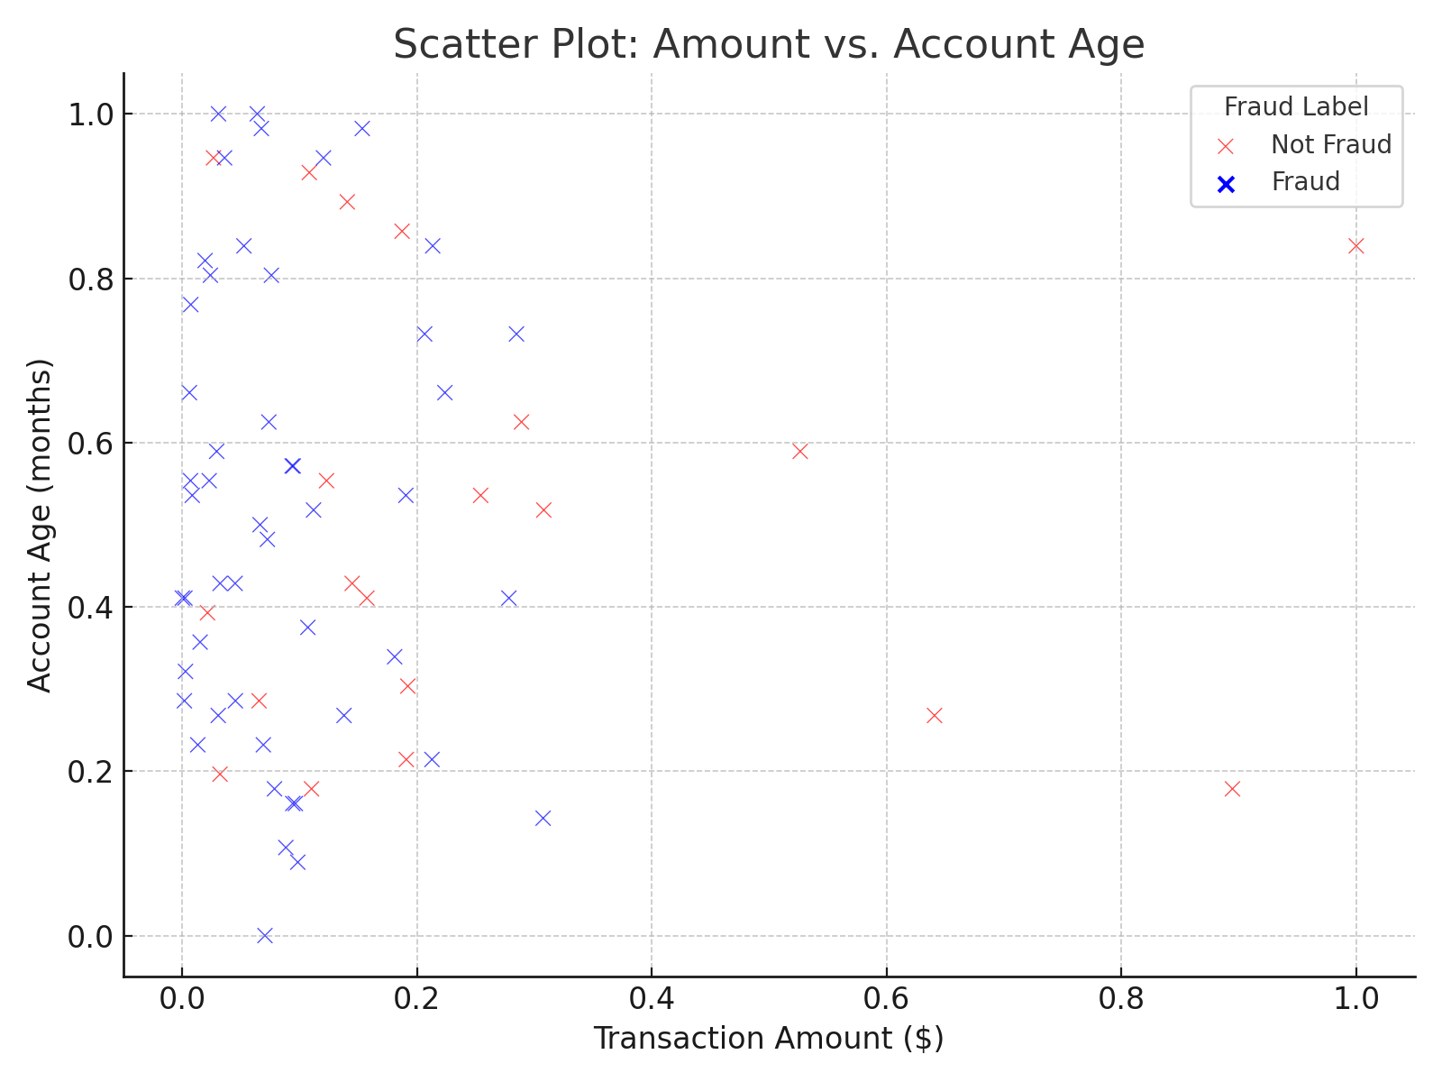
Feature Extraction
Selected two input features from the dataset: Amount and Account_age
No new features were engineered — original values were used directly
Chosen features are numeric and continuous, suitable for all ML models used
These features were selected based on domain relevance and availability in the dataset

Slide 9
Model Descriptions
Decision Tree (DT)
Algorithm: CART (Classification and Regression Tree)
Criterion: Gini index (default)
Random State: 42 (ensures reproducibility)
Max Depth: Default (tree expands until pure or minimal samples)
k-Nearest Neighbors (K-NN)
Neighbors (k): 5
Distance Metric: Euclidean distance (default)
Weighting: Uniform (all neighbors weighted equally)
Support Vector Machine (SVM)
Kernel: Radial Basis Function (RBF)
Probability Estimation: Enabled (probability=True)
C (Regularization): Default (1.0)
Gamma: Auto-selected based on data

Slide 10
Artificial Neural Network (ANN)
Model: Multi-layer Perceptron (MLPClassifier)
Hidden Layers: 2 layers — 10 neurons and 5 neurons
Activation Function: ReLU (default)
Optimizer: Adam
Max Iterations: 500
Random State: 42

Slide 11
Model Performance
Training Setup
We used a simple train-test split due to the small dataset size
Training and test sets were saved as Excel files (INPUT/TRAIN and INPUT/TEST)
No explicit validation set was used — evaluation was done on the test set only
Scaling was applied only for SVM and ANN
Performance Measures Used
We evaluated each model using the following metrics:
Accuracy – Overall correctness of the model
Precision & Recall – Key indicators for fraud detection
F1-score – Balance of precision and recall
AUC – Area under the ROC curve (for models that support predict_proba)
Confusion Matrix – To show true/false positives and negatives

Slide 12
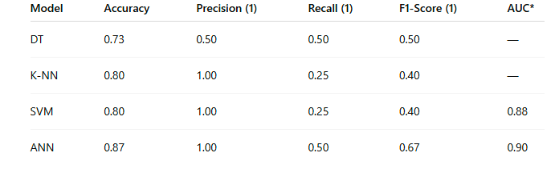
Discussion of Performance
ANN performed best overall with the highest accuracy (87%) and solid balance on all metrics
SVM and K-NN had perfect precision on fraud cases but poor recall — often missed true frauds
Decision Tree gave balanced but modest performance (50% precision & recall for fraud)
All models tended to over-predict the majority class (not fraud), which is typical for small and imbalanced datasets

